Slide 1


Chetan Thakur-100921763
Masum Thakar-100927477 Himanshu-100920807
Digant-100938960
OmniTune
OmniTune The Future of Personalized Music Experience

Slide 2



About OmniTune
A cloud-hosted music recommendation app using Flutter or React-js (Frontend) or and Python (Backend).
Frontend: Flutter (Dart) / React-JS
User-friendly UI
Cross-platform compatibility
Firebase/AWS Amplify for authentication
Backend: Python (FastAPI/Django)
Machine learning-based recommendations
NLP for lyrics analysis
Audio fingerprinting using Librosa
Database: PostgreSQL / NoSQL
User profiles and activity tracking
Song metadata and search indexing

Slide 3
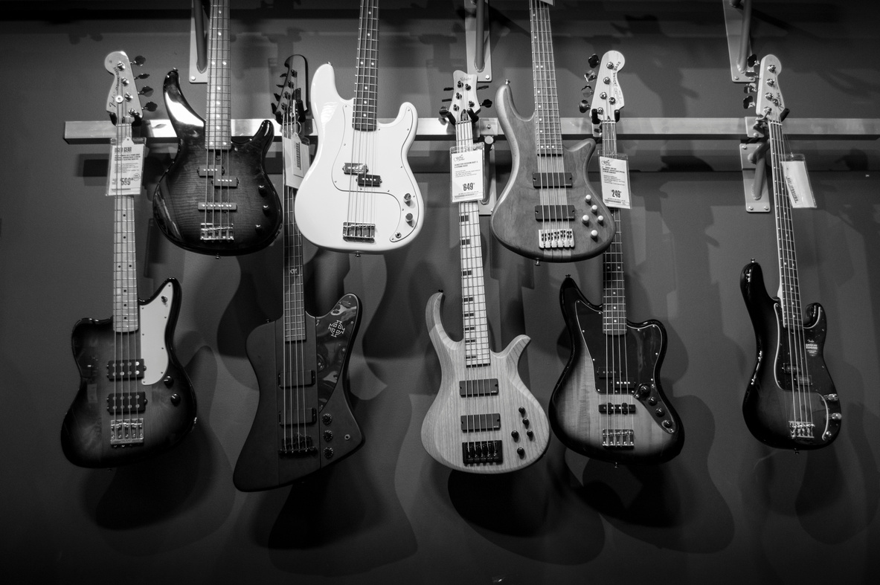


About Features
Basic Features:
User profile creation & preference tracking
Genre classification & music search
Collaborative & content-based filtering
Auto-generated playlists
Advanced Features:
Deep Learning for personalized recommendations
Mood detection via facial & voice analysis
Music fingerprinting for beat & melody recognition
AI-powered DJ adapting in real-time
Social integration for playlist sharing

Slide 4

Why OmniTune?
Innovative Approach:
AI-powered deep personalization
Cutting-edge audio & lyric analysis
User-Centric Experience:
Intuitive and engaging UI
Real-time analytics & insights
Scalable & Secure:
Cloud-hosted for global accessibility
Robust security & data privacy
Join the Future of Music with OmniTune!

